Slide 1

SecureShare — End-to-End Encrypted File Sharing Platform
A Secure Way to Share Files with Complete Privacy
Developed by: Sanyam Chanana(23215054) , Swyam Agarwal(23215066) , Amogh Bakshi(23215012) (5BCA A)
Institution: CHRIST University, Delhi-NCR Campus
Mentor: Dr. Vandana Sharma
Technologies: HTML, CSS, JavaScript, Node.js, WebCrypto API

Slide 2
Project Overview
Objective: To develop a secure, web-based file-sharing platform that ensures privacy through client-side encryption and enables safe information exchange over the internet.
Key Highlights:
Pre-Upload Encryption
Zero Server Access
Files are encrypted before upload using AES-256 encryption.
Server never accesses plain (unencrypted) data.
Recipient-Only Decryption
Cyber Awareness
Only the intended recipient can decrypt the files.
Integrated cyber awareness features — Cyber News and Report Cybercrime.
"Your files, your control — zero compromise."

Slide 3

Problem Statement
Challenges in Traditional File-Sharing Systems:
Unencrypted Storage
Vulnerable Systems
Files stored in unencrypted form on cloud servers.
Centralized systems vulnerable to breaches and insider attacks.
Limited Control
Weak Security
Lack of user control over data privacy.
Weak password and token mechanisms expose users to risks.
Need:
A privacy-first file-sharing platform ensuring end-to-end encryption, zero data exposure, and awareness of cybersecurity best practices.

Slide 4
Project Goals & Features
Goals:
Key Features:
Ensure true end-to-end encryption (E2EE).
Client-side AES-256 encryption & decryption.
Provide a simple and secure sharing experience.
Instant file uploads with unique shareable links.
Promote cybersecurity awareness and safe online behavior.
Cyber News updates from trusted cybersecurity sources.
Report Cybercrime portal for responsible web use.
OWASP security measures (Helmet.js, CSRF protection).

Slide 5
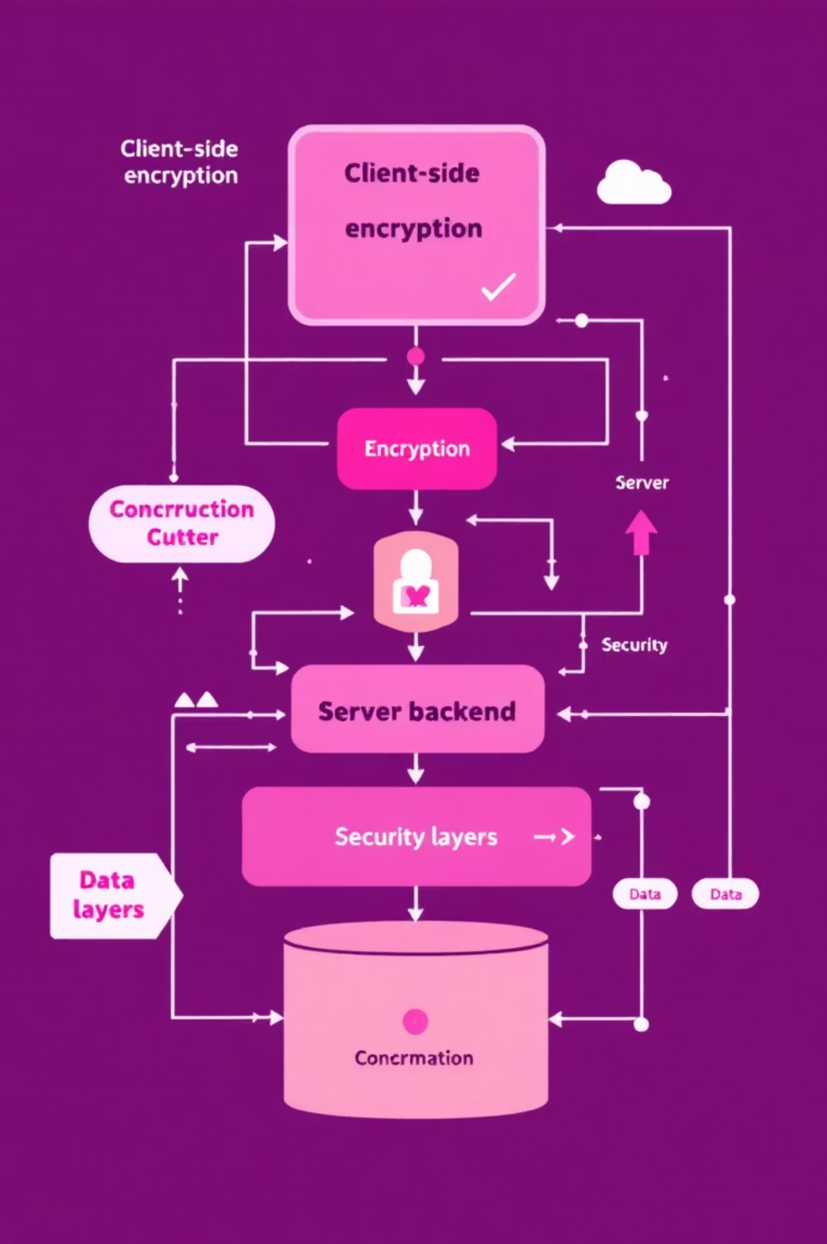
System Architecture
Architecture Overview:
01
Frontend (Client-Side)
HTML, CSS, JavaScript for UI/UX
WebCrypto API for encryption & decryption
02
Backend (Server-Side)
Node.js + Express.js
Crypto Module for token generation & hashing
bcrypt/argon2 for password storage
03
Security Layer
Helmet.js for securing HTTP headers
Csurf for CSRF protection
HTTPS via Let's Encrypt for secure communication
04
Testing & Validation
OWASP ZAP used for vulnerability scanning

Slide 6
Tools & Technologies Used
Category
Tools / Libraries
Purpose
Encryption
WebCrypto API
AES-256 encryption/decryption on client side
Backend Security
Node.js Crypto Module
Secure tokens, hashing
Password Security
bcrypt / argon2
Password hashing & validation
Web Protection
Helmet.js + Csurf
Prevent XSS, CSRF, and other OWASP threats
HTTPS
Let's Encrypt
Secure encrypted communication
Testing
OWASP ZAP
Vulnerability scanning and threat detection

Slide 7






Workflow of the Application
Step 1
User uploads file → encrypted on client-side (WebCrypto API)
Step 2
Encrypted file sent to the server
Step 3
Server stores encrypted version only (no plaintext ever stored)
Step 4
User gets a secure shareable link with encryption key hash
Step 5
Recipient downloads and decrypts using correct key
Step 6
Cyber News and Report Cybercrime pages provide awareness & support

Slide 8

Security Implementations
End-to-End Encryption (E2EE)
Authentication & Hashing
AES-256 algorithm for encryption
bcrypt/argon2 for password hashing
Randomized IV (Initialization Vector) for each upload
Crypto module for random secure tokens
Web Security Protections
Testing
Helmet.js: Prevents header-based attacks (XSS, Clickjacking)
Conducted vulnerability testing using OWASP ZAP before deployment
CSRF Protection via Csurf
HTTPS via Let's Encrypt SSL

Slide 9
Results & Highlights
Achievements:
Secure file sharing without exposing plaintext to the server
Awareness through Cyber News integration
Simplified interface with strong backend security
Successfully passed OWASP ZAP vulnerability scan
Performance Metrics:
<2s
100%
0
File Encryption Speed
Security Score
Data Leakage
AES-256, < 2s for small files
OWASP top-10 compliance
Zero data leakage confirmed during testing

Slide 10
SecureShare — User Interface and Functional Screens

Slide 11
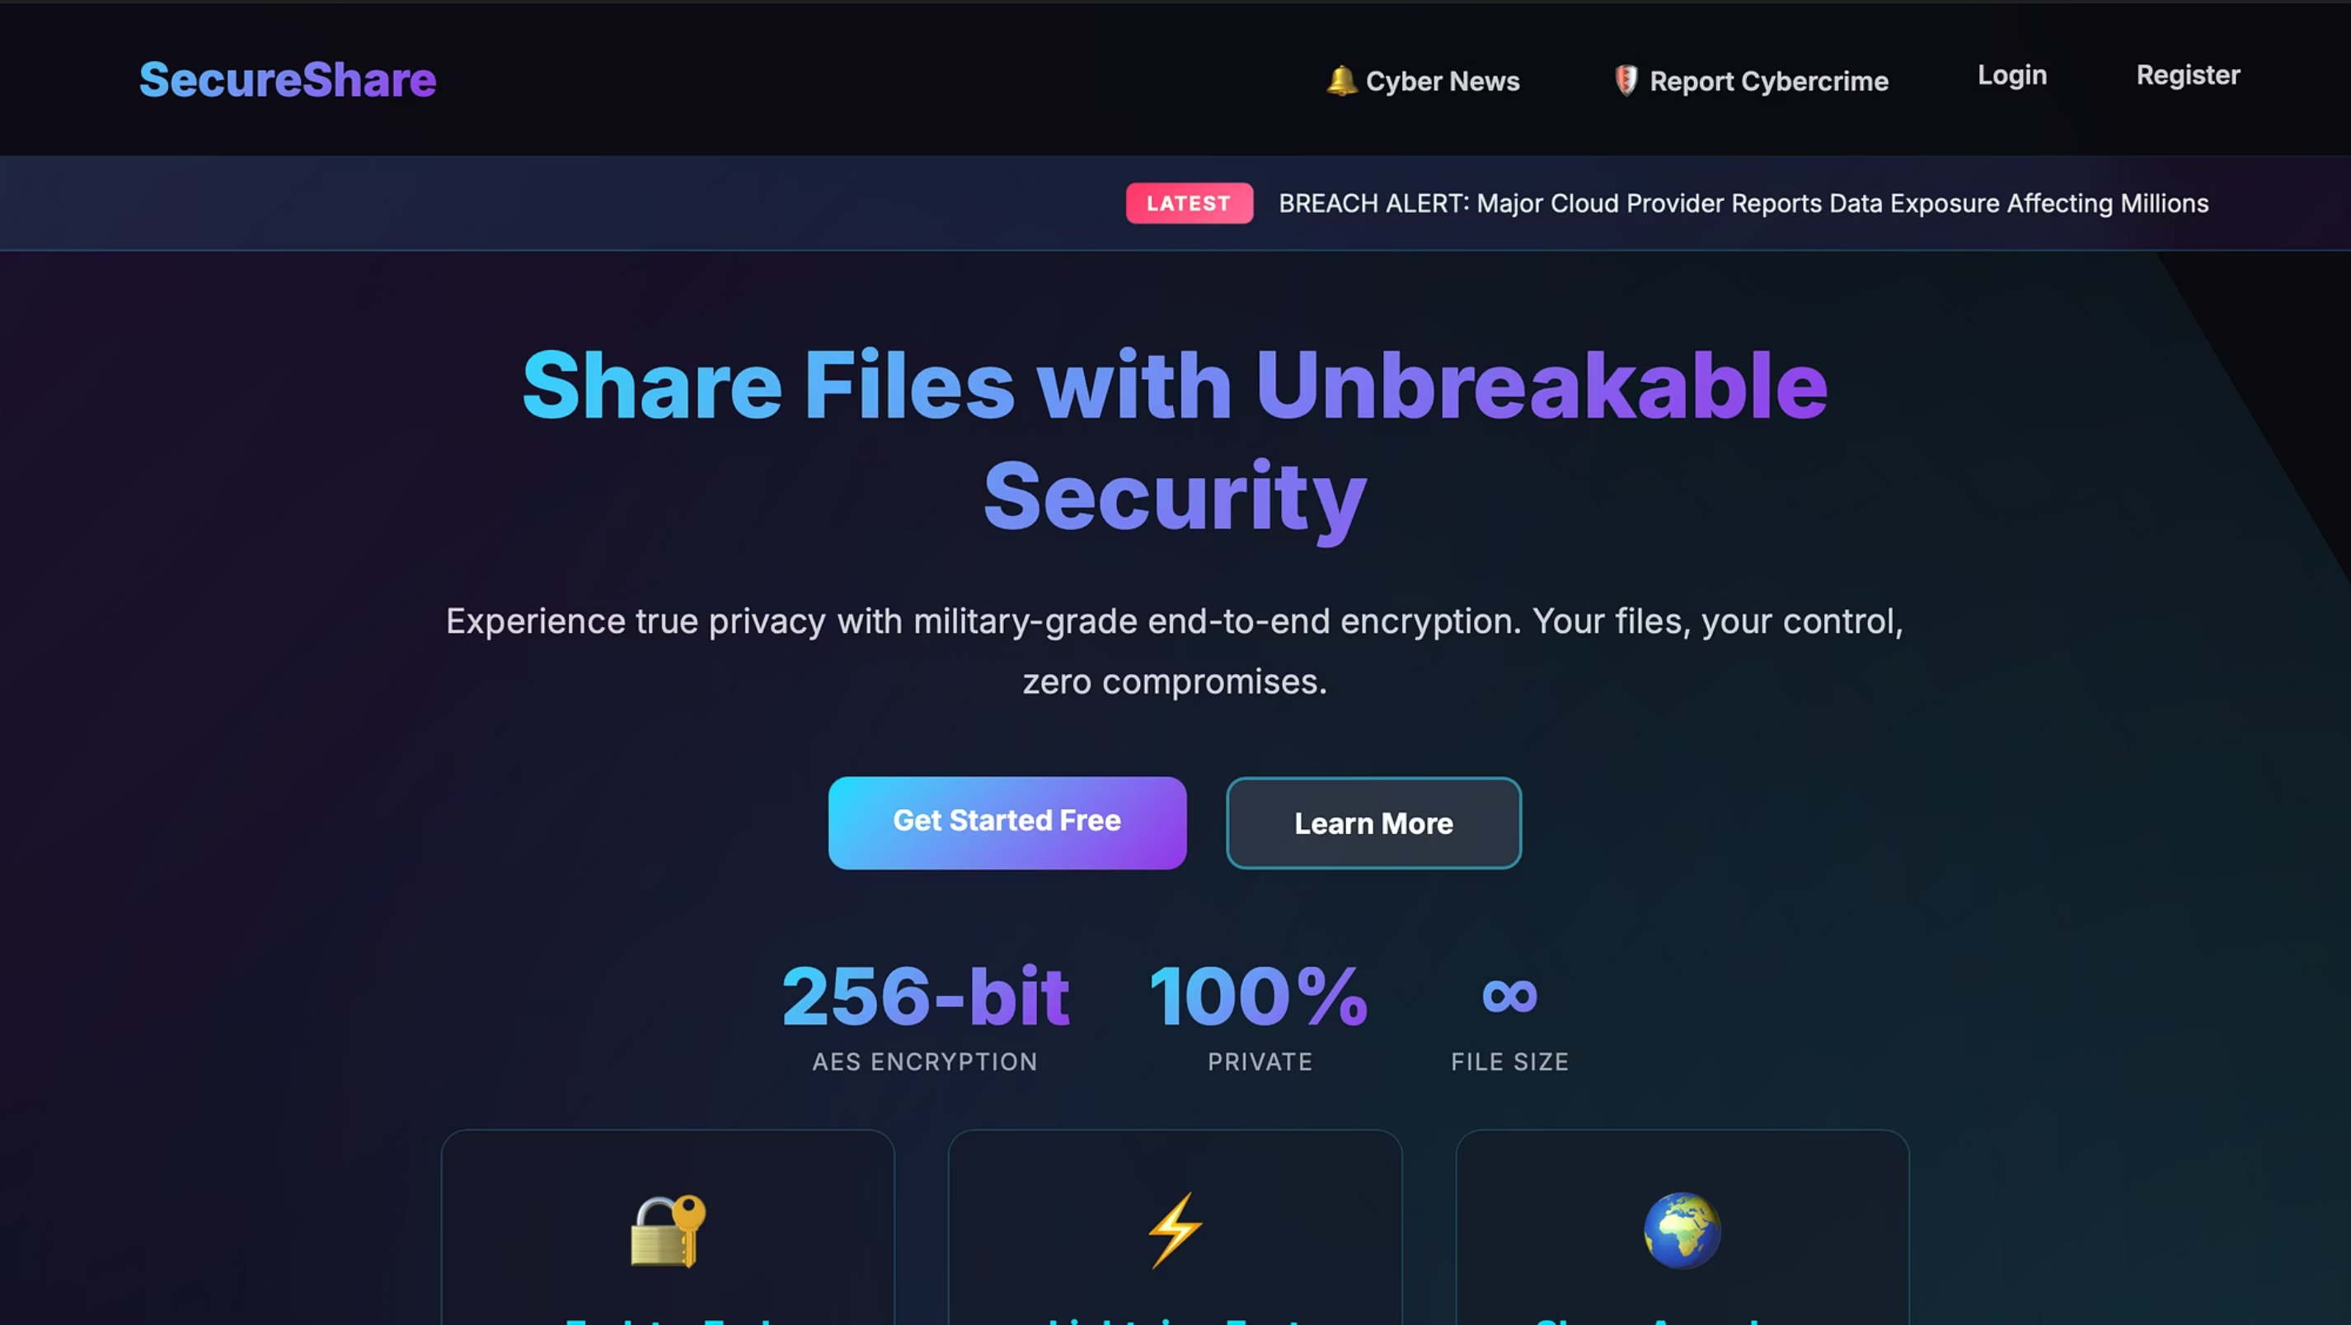
Home Page

Slide 12
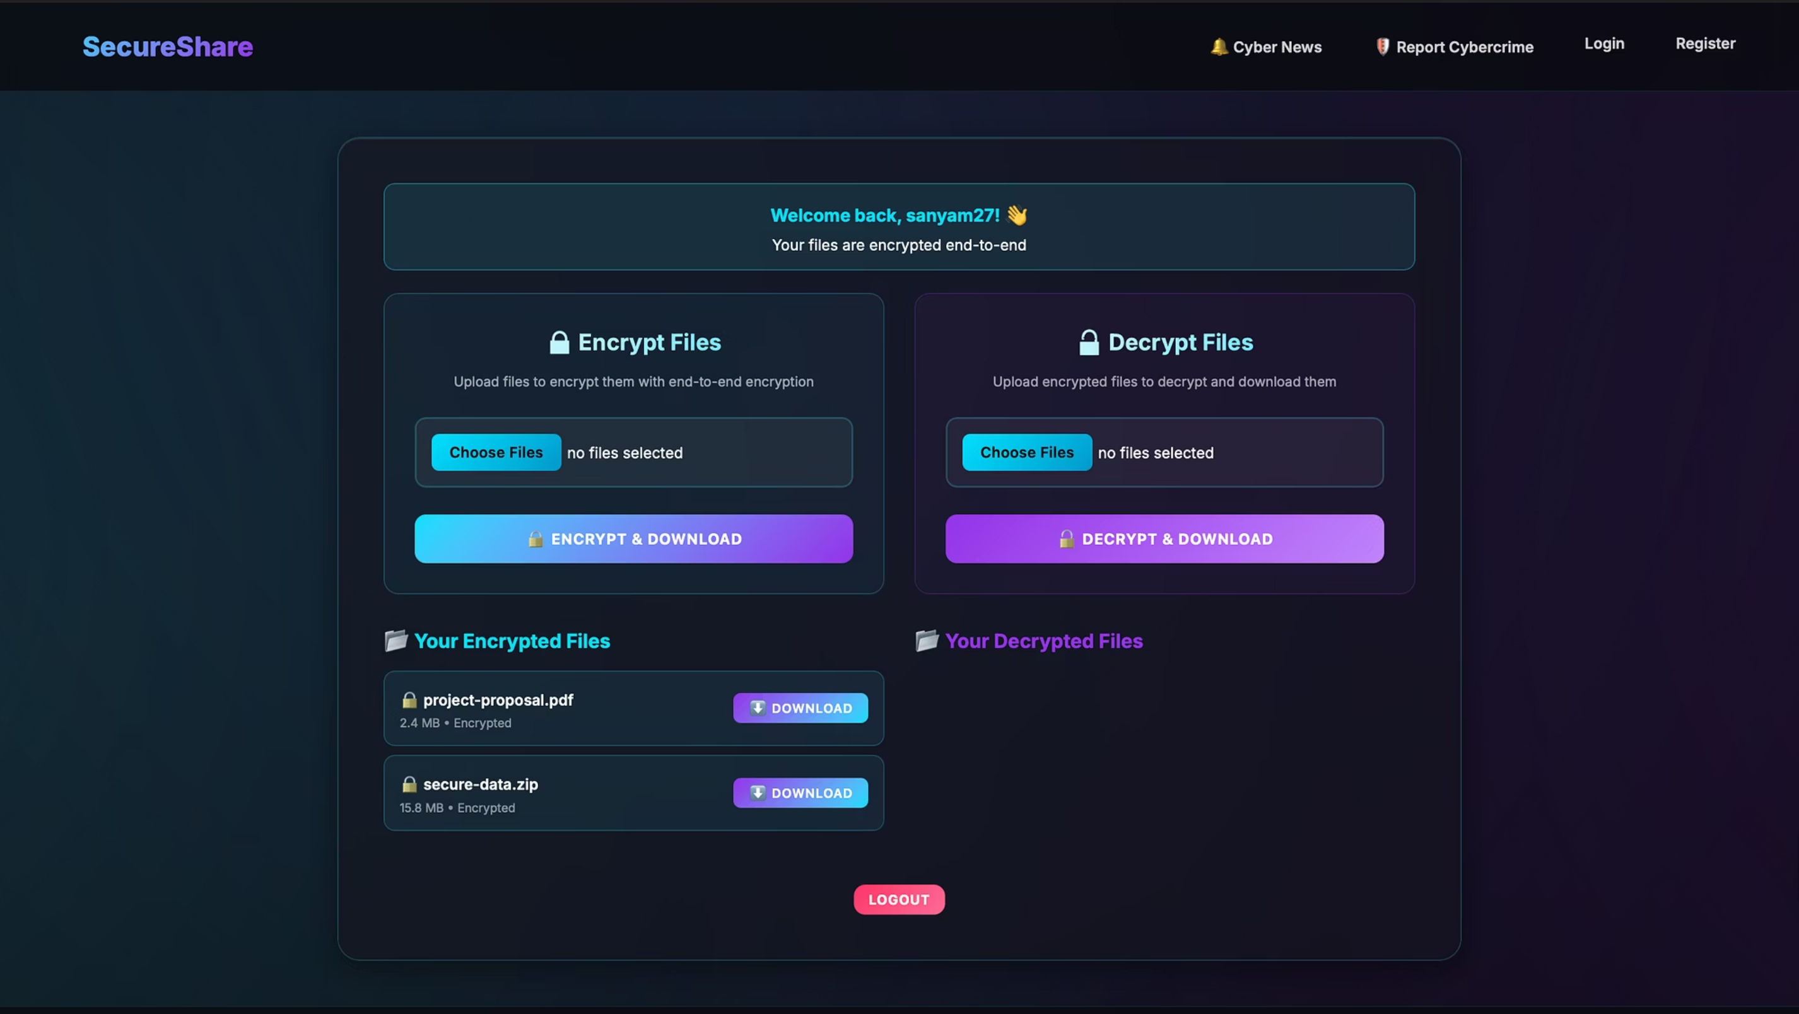
SecureShare UI

Slide 13
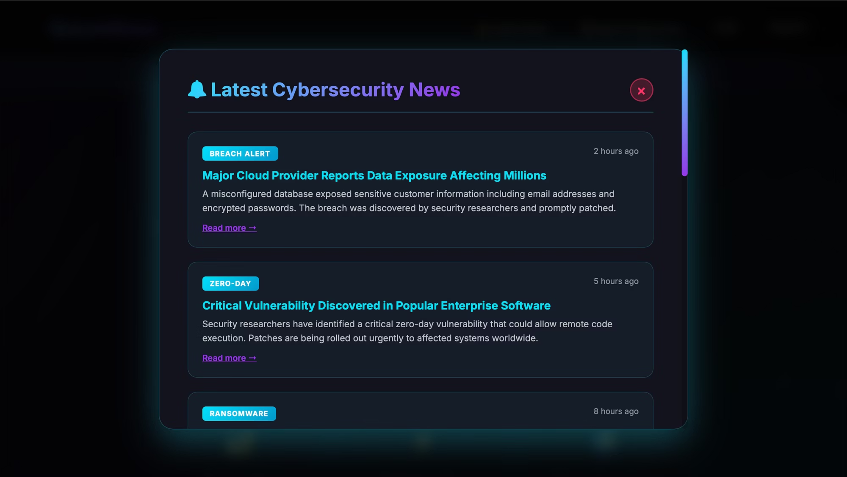

Slide 14
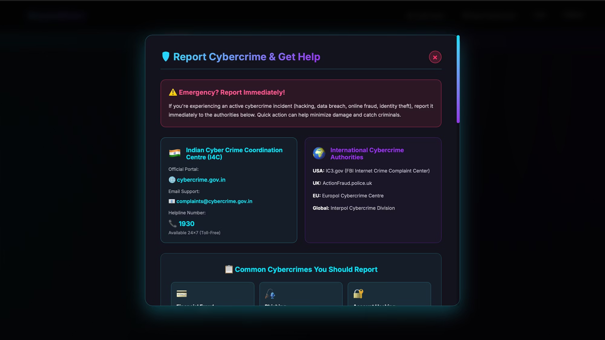

Slide 15
Conclusion & Future Scope
Conclusion:
Future Enhancements:
SecureShare successfully demonstrates a real-world implementation of end-to-end encryption in file sharing. It bridges the gap between usability and security while promoting cyber awareness among users.
Add 2FA authentication.
Integrate decentralized storage (IPFS).
Implement file expiry and self-destruct options.
Add AI-based cyber threat detection on uploaded files.
"SecureShare is not just a file-sharing app — it's a step toward a more private and secure digital world."

